Slide 1
Response of an ensemble of 1-D columns to periodic stimulus
Vincent Baker
Drexel University Department of Physics

Slide 2
Approach
Stimulate a weakly-connected ensemble with a periodic stimulus (sine wave)
Observe response to frequency and phase differences in stimulus

Slide 3
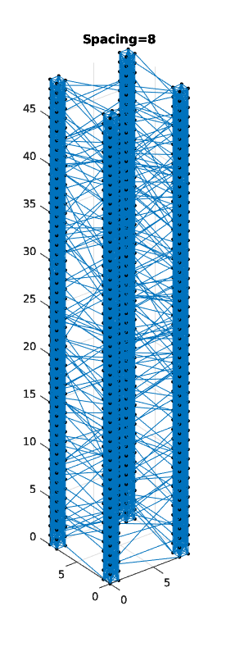
Column ensemble
Ensemble of 4 columns
Each constituent column is 4x4x50
Columns spaced 8 units apart
Strongly connected columns, weak interconnections
Stimulated bottom 4 layers with sine input

Slide 4
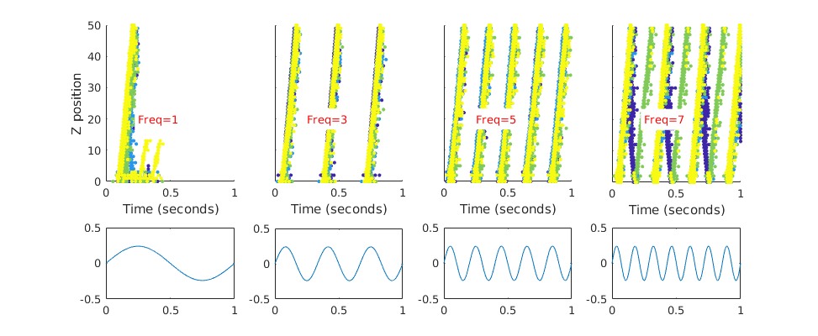
Frequency dependence
At very low frequencies each cycle can produce one or multiple waves
At medium frequencies each cycle produces one wave
At high frequencies output is complex
Firing diagram, color-coded by column
Stimulus

Slide 5
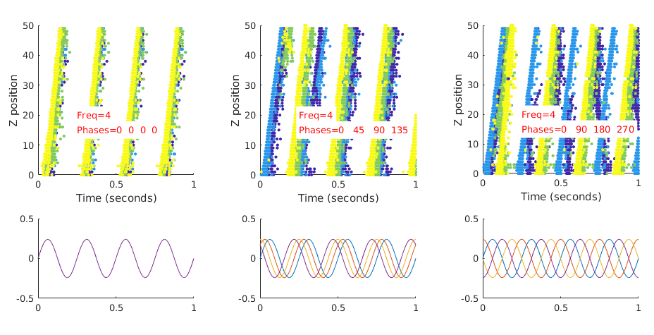
Phase dependence
Changed the phase of the stimulus to each column
Ensemble tends to aggregate response if stimulus is close to in-phase, complex response when stimulus is out of phase
Firing diagram, color-coded by column
Stimulus, colord-coded by column

